Slide 1
Vibration Analysis

Slide 2
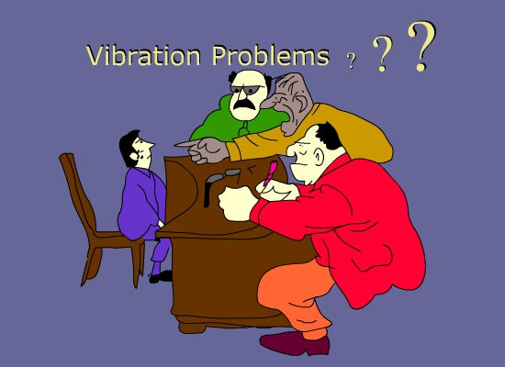
Purpose of Vibration Analysis
To Identify Health Condition
To detect the defects and
Inaccuracies
To Pinpoint the Defective
locations

Slide 3
NO
PROBLEMS ON MY MACHINES

Slide 4
ONLY PROBLEM IS
VIBRATION

Slide 5
“VIBRATION ANALYSIS”
ALONE CAN IDENTIFY
> 95%
OF MACHINERY PROBLEMS

Slide 6
Basic Theory Of Vibration
Simple Spring Mass System
Max Acc
Mim Vel
Upper
Limit
Neutral
Position
Max Vel
Mim Acc
Displacement
Lower
Position
Max Acc
Mim Vel
It follows sine curve.

Slide 7
Time Waveform
+
Heavy Spot
0
Amplitude
Time
-
Rotation
1 revolution
3600 RPM = 3600 cycles per minute
60 Hz = 60 cycles per second
1 Order = One times turning speed

Slide 8
Frequency & Amplitude
Frequency:
How many times oscillation is occurring
for a given time period?
Units: Cycles Per Sec or Hertz, CPM
Amplitude:
It is the magnitude of vibration signal.
Units: Micron, MM/Sec, g’s or M/Sec²

Slide 9
Physical Significance Of Vibration Characteristics
Frequency - What is vibrating?
Source of the vibration.
Amplitude - How much is it vibrating?
Size (severity) of the problem.
Phase Angle - How is it vibrating?
Cause of the vibration.

Slide 10
Frequency Measurement
60 RPM
= 1 Rev / s
= 1 Hz

Slide 11
Amplitude Measurement
1. Displacement :
The distance a structure moves or vibrates from its reference or rest position.
Unit : Microns(p-p), mils(p-p)
2. Velocity :
Rate of change of displacement. It is the
measure of the speed at which the mass is
vibrating during its oscillation.
Unit : MM/Sec, Inch/sec (RMS or Peak)
3. Acceleration :
It is the rate of change of velocity. The
greater the rate of change of velocity the
greater the forces (F=ma) on the machines.
Unit : M/Sec², Inch/sec² , g’s (RMS)

Slide 12
A
B
C
a
t
b
t
c
t

Slide 13
+
a
v
t
d

Slide 14
Physical Significance Of Vibration Amplitude
Displacement : Stress Indicator
Velocity : Fatigue Indicator
Acceleration : Force Indicator

Slide 15
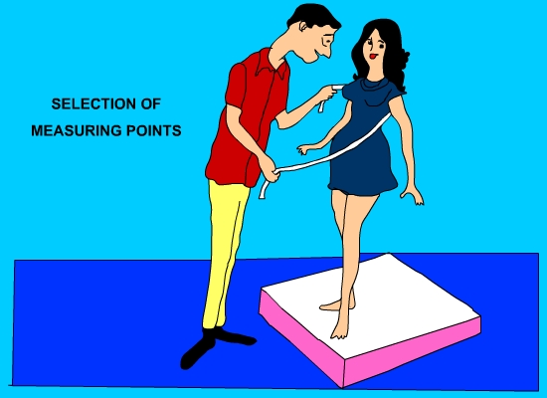

Slide 16
When To Use Disp., Vel. & Acc.?
VIBRATION SENSITIVITY
DISPLACEMENT
10
1
.1
.01
.001
VELOCITY
ACCELERATION
60 600 6000 60000 600 000
FREQUENCY
CPM

Slide 17
What Is The Advantage Of Using Velocity?
Flat frequency range compared to displacement & acceleration.
Almost all machines generate fault frequency between 600CPM to 60KCPM
Velocity indicates fatigue.
Velocity is the best indicator of vibration severity.

Slide 18
Scales Of Amplitude
Peak
Av.
RMS
Peak to Peak
Peak - a
Peak to Peak - 2a
RMS - 0.707 a
Average - 0.637 a

Slide 19
Vibration Transducers
Produces electrical signal of vibratory motion
Proximity Probe - Displacement
Velocity Probe - Velocity
Accelerometer - Acceleration

Slide 20
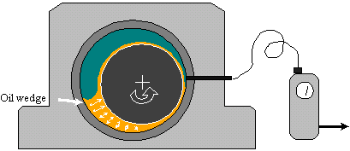
Proximity Probe

Slide 21
Permanently installed on large machines with sleeve bearings.
Measures relative displacement between the bearing housing(probe tip) and the rotating shaft.
Called Eddy Current Probe
Frequency range 0 to 60,000 CPM

Slide 22
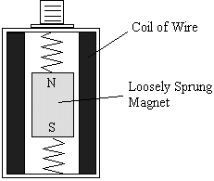
Velocity Probe

Slide 23
Oldest of all.
Produces signal proportional to velocity.
Self generating and needs no conditioning electronics.
It is heavy, complex and expensive.
Frequency response from 600CPM to 60,000CPM
Temperature sensitive

Slide 24
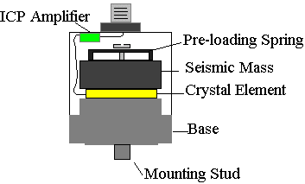
Accelerometer

Slide 25
Produces signal proportional to acceleration of seismic mass.
Extremely linear amplitude sense.
Large Frequency range
Smaller in size

Slide 26
Time Waveform
+
Heavy Spot
0
Amplitude
Time
-
Rotation
1 revolution
3600 RPM = 3600 cycles per minute
60 Hz = 60 cycles per second
1 Order = One times turning speed

Slide 27
Time Waveform
+
0
Time
Amplitude
-
1000 RPM
1 revolution
4 blades = Vibration occurs 4 times per revolution
4 X 1000 RPM = Vibration occurs at 4000 cycles per minute
= 4000 CPM

Slide 28
Time Waveform
+
0
Amplitude
Time
12 tooth gear
-
1 revolution
1000 RPM
12 teeth are meshing every revolution of the gear
12 x 1000 RPM = vibration occurs at 12,000 cycles per minute
= 12,000 cpm = 200 Hz

Slide 29
Time Waveform
+
0
Time
-
+
0
Time
-
+
0
Time
-

Slide 30
Time Waveform
+
0
Time
-
Time Waveform contains all the different frequencies mixed together.

Slide 31
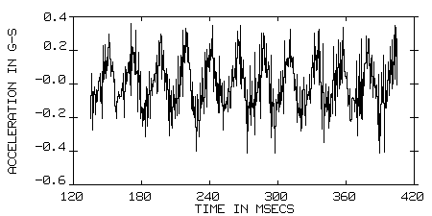
Time Waveform
Example of a time waveform

Slide 32
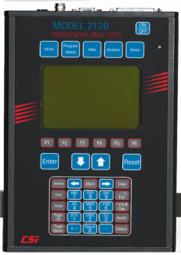
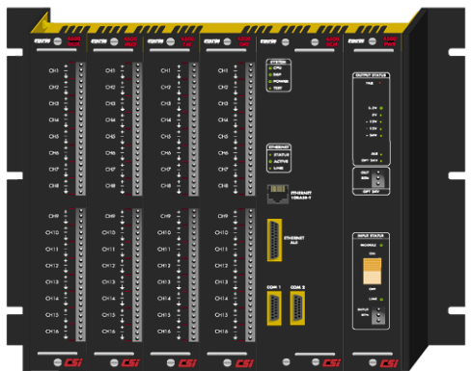
Signal Acquisition
Transducer
Waveform
Amplitude
Overall
Energy
Time
FFT
Spectrum
Amplitude
Frequency

Slide 33
FFT SPECTRUM A calculation method of converting a time waveform to a frequency display that shows the relationship of discrete frequencies and their amplitudes

Slide 34
Frequency Domain
FFT - Fast Fourier Transform
Separates individual frequencies
Detects how much vibration at each frequency

Slide 35
FFT Signal Processing

Slide 36
Frequency Domain
+
0
Time
-
Frequency
1x
+
0
Time
-
Frequency
4x
+
0
Time
Frequency
-
12x

Slide 37
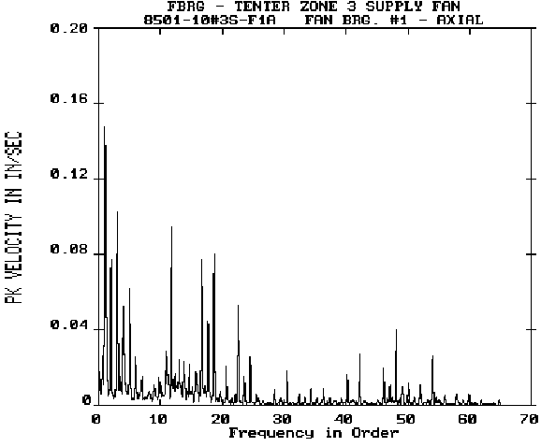
A Typical FFT Spectrum
Many distinct peaks

Slide 38
A Typical FFT Spectrum
Specific peaks typically correlate to
Specific machine faults
Related to machine speed

Slide 39
Phase

Slide 40
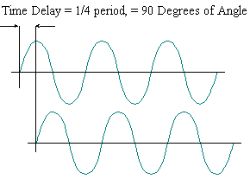
What Is Phase?
Phase is a measure of relative time difference between two sine waves.
Trigger Any event which can be used as a timing reference.
Keyphasor ( phase reference sensor ) A signal used in rotating machinery measurements , generated by a sensor observing a once per revolution event .

Slide 41
Importance Of Phase
Phase is a relative measurement.
Provides information how one part of a machine is vibrating compared to other.
Confirmatory tool for problems like-
1. Unbalance
2. Misalignment
3. Eccentric Rotor, Bent Shaft.
4. Mechanical Looseness, Structural Weakness, Soft Foot.
5. Resonance.
6. Cocked bearing.
No correlation with Bearing defects, Gear defects,
Electrical motor defect.

Slide 42
How Phase Angle Is Measured?
The Phase Angle is the angle (in degrees) the
shaft travels from the start of data collection to
when the sensor experiences maximum positive
force.
For example, the phase angle is 90° if the sensor
experiences its maximum positive force at 90°
after data collection was initiated by the
tachometer.

Slide 43
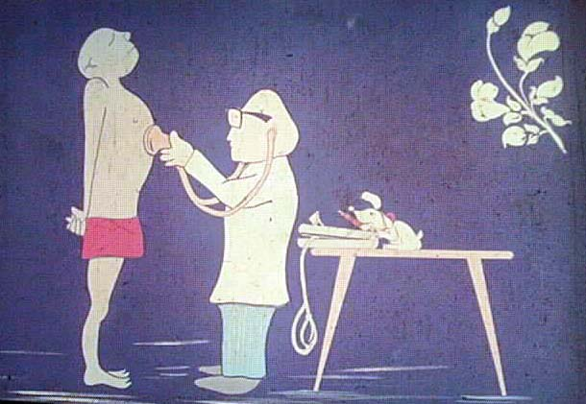
We are Machine Doctors

Slide 44
Diagnosing Machine Faults
Unbalance
Misalignment
General looseness or wear
Bearing defects
Gear defects
Belt defects
Electrical Faults
Journal Bearing Faults
Resonance

Slide 45
Unbalance

Slide 46
What is unbalance?
The force created by a rotating body when its center of mass is offset from its center of rotation
Center of Mass = Center of Rotation
Heavy Spot
Center of Mass
Center of Shaft
Rotation

Slide 47
Causes of unbalance
Improper assembly
Material Buildup
Wear
Broken or missing parts

Slide 48
Characteristics of unbalance
High radial peaks at 1X shaft RPM
Low axial vibration at 1X shaft RPM
Low harmonics of shaft RPM
1X RPM sinusoidal pattern in the time waveform
Can cause other faults to appear, especially looseness

Slide 49
Unbalance
Imbalance typically appears at
the turning speed of the machine
Imbalance

Slide 50
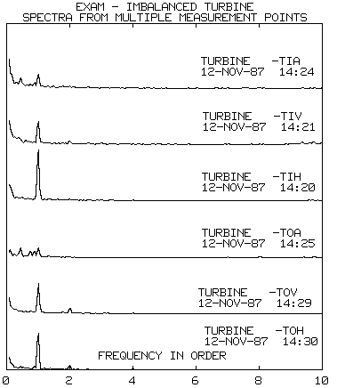
Unbalance
Radial vibration at 1X shaft RPM is much more significant than in the axial direction
Freq: 60.04 Hz
Order: 1.010
Spec: .390

Slide 51
What is Misalignment?
Deviation from a common centerline during operation.

Slide 52


Slide 53
Types of Misalignment
Offset
Angular
Both

Slide 54
Misalignment
Characteristics:
High axial levels
High axial at 1, 2 and 3X shaft RPM
High radial at 1, 2 and 3X shaft RPM
Repeatable periodic waveform with one or two clear peaks per revolution
Phase readings show a 180º shift across the coupling

Slide 55

Misalignment: Characteristics
Angular - Axial vibration at 1X RPM
Offset - Radial vibration at 2X or 3X RPM
Harmonics (3X-10X) generates as severity increases.
If the 2X amplitude more than 50% of 1X then
coupling damage starts.
If the 2X amplitude more than 150% of 1X then
machine should be stopped for correction.

Slide 56
Misalignment
Misalignment typically shows up
at either 1 or 2 x turning speeds
Misalignment

Slide 57
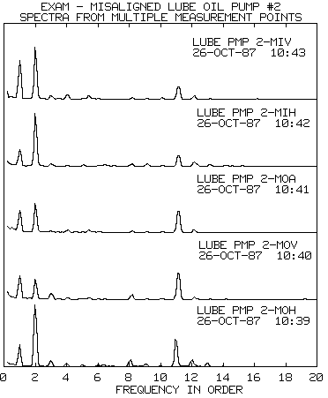
Misalignment
2X shaft RPM is dominant location of vibration
Vane pass is due to 11 blade pump impeller
Vane Pass
Freq: 59.50
Order: 2.010
Spec: .640

Slide 58
Mechanical Looseness

Slide 59
Causes
It alone can not create vibration but in the influence of Unbalance, Misalignment, Bearing problems it amplify the amplitude.
It should be corrected first.

Slide 60
Types of Looseness
Structural Looseness
- Base mount
- Split Casings
- Bearing caps
- Bearing supports
Rotating Element Looseness
- Impellers
- Fans
- Bearings
- Couplings

Slide 61
Characteristics of Looseness
Many Harmonics of running speed
Directional in nature; horizontal and vertical amplitudes may differ greatly
Occasional half-harmonics
Random, non-periodic time waveform
Broad based skirts on peaks in the Spectrum, possible elevated floor also

Slide 62
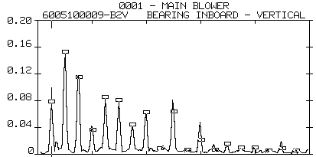
Mechanical Looseness
Multiple harmonics of running speed
2X
Running speed harmonics
3X
1X
6X
5X
8X
7X
4X

Slide 63
Mechanical Looseness
Looseness shows up as
multiples of turning speed
Looseness

Slide 64
Rolling Element Bearing

Slide 65
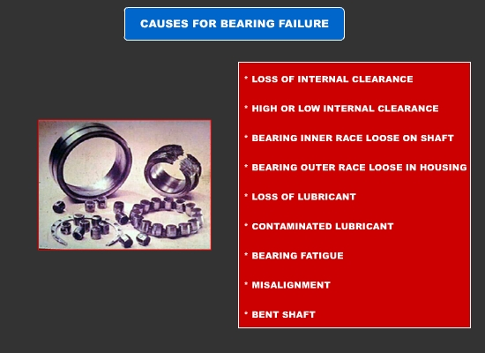
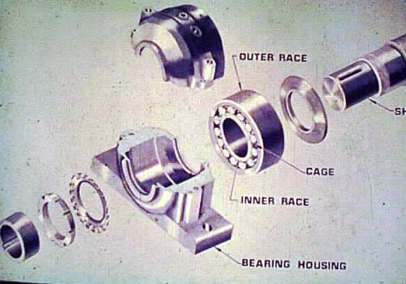

Slide 66
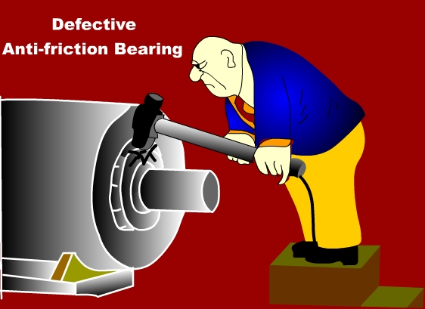

Slide 67
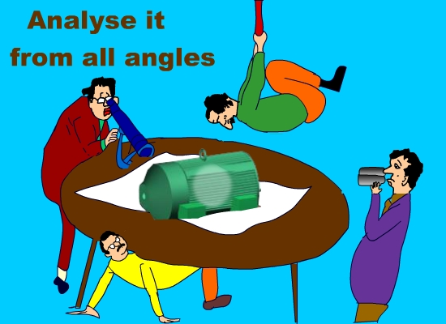

Slide 68
Why Does Bearing Fail?
1. Improper lubrication
2. Contaminated lubrication
3. Heavier loading from unbalance,
misalignment, bent shaft etc.
4. Improper handling or installation.
5. Old age (Surface fatigue) .

Slide 69
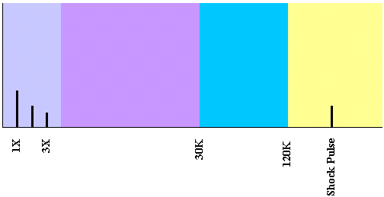
Bearing Failure Stages
Stage - 1
Earliest indications of bearing problems appear in the ultrasonic frequency ranging from 1,200k to 3,600 kCPM.
Spike Energy,PeakVue, HFD, and Shock Pulse evaluate these frequencies.

Slide 70
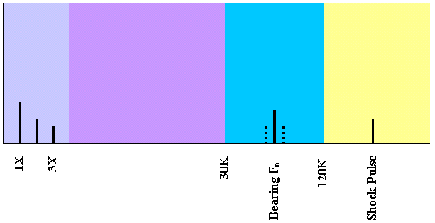
Stage - 2
Slight bearing defects begin to ring bearing component natural frequencies, which predominantly occur in 30k to 120K CPM range.
Sideband frequencies appear above and below nof stage 2.

Slide 71
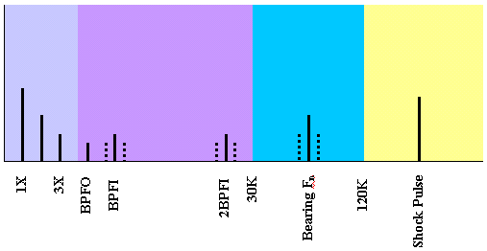
Stage - 3
Bearing defect frequencies and harmonics appear.
More defect frequencies appear and nos of sidebands grow, both around these and bearing natural frequencies.
When well-formed sidebands accompany bearing defect frequency harmonics
Bearing has to be replaced.

Slide 72
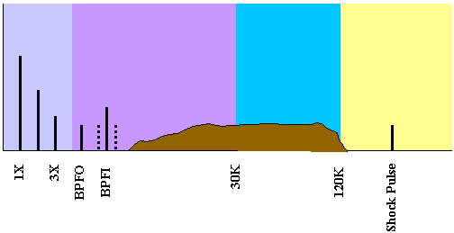
Stage - 4
Towards the end-
Amplitude of 1X and other running speed harmonics will increase.
Discrete bearing defect and component natural frequencies actually begin to disappear and are replaced by random, broad band high frequency noise floor.
Amplitude of both high frequency noise floor and spike energy may decrease, but prior to failure, spike energy will usually grow to excessive amplitudes.

Slide 73
Rolling element bearings
FTF = Fundamental Train Frequency
BSF = Ball Spin Frequency
BPFO = Ball Pass Frequency Outer race
BPFI = Ball Pass Frequency Inner race
FTF
1
.
1
d
.
cos
Φ
.
RPM
RPM = Shaft rotation
d = Rolling element diameter
D = Pitch diameter
N = No. of rolling elements
= Contact angle
2
D
D
d
2
BSF
.
1
.
cos
Φ
.
RPM
2
.
d
D
BPFO
N
.
FTF
BPFI
N
.
(
RPM - FTF)

Slide 74
Rolling element bearings
What do the bearing frequencies mean?
If:
FTF = 0.381 * RPM
BSF = 1.981 * RPM
BPFO = 3.047 * RPM
BPFI = 4.952 * RPM
During one shaft revolution:
The cage rotates 0.381 revolutions
The ball spins 1.981 revolutions
4.952 balls pass an inner race defect
3.047 balls pass an outer race defect

Slide 75
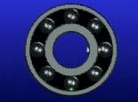
Anti-friction Bearing Faults
Four different bearing frequencies
Ball Spin Frequency
(BSF)
Fundamental Train
Frequency
(FTF)
Ball Pass Frequency
Inner Race
(BPFI)
Ball Pass Frequency
Outer Race
(BPFO)

Slide 76
Envelope Detection
Repetitive bearing & gear mesh activity create vibration signals of much lower amplitude & higher frequencies than rotational and structural vibration signals
Enveloping – Filtering out the low frequency rotational vibration signals and to enhance the repetitive components of a bearing defect signals occurring in the bearing defect frequency range. Envelope detection is most common in rolling elements bearing and gear mesh analysis where a low amplitude repetitive vibration signal may be hidden by the machine’s rotational & structural vibration noise.
For e.g..
If a rolling element bearing has a defect on its outer race , each roller over-rolls the defect as it goes by and causes a small , repetitive vibration signal at the bearing defect frequency . However , this vibration signal is of such low energy that , with overall vibration monitoring , it is lost in the machine’s other rotational & structural vibration noise. Envelope detection filters out low rotational signals and enhances the bearing’s repetitive impact type signals to focus on repetitive events in the bearing defect frequency range( for eg repetitive bearing & gear tooth vibration signals)
In recent times this measurement method has proven to be a successful indicator of major class of machine problems . Faults in roller element bearings, defective teeth in gear boxes , paper mill felt discontinuities , and electric motor / stator problems are all applications for acceleration enveloping.

Slide 77
Gear Box

Slide 78
Gear box
Z1
RPM1
RPM2
Z2
GMF (Gear Mesh Frequency)
Z1 .RPM1 = Z2 .RPM2
where Z = no. of teeth and RPM shaft speed
Mating gears produce only one ‘Gear Mesh Frequency’

Slide 79
Gear Box Defects
Tooth wear
Gear eccentricity & backlash
Gear misalignment
Cracked or broken tooth
Hunting tooth

Slide 80
Gear box
1/Rps
Z.Rps
Z.Rps-Rps
Z.Rps+Rps
velocity
velocity
Z.Rps-2 Rps
Z.Rps+2 Rps
frequency
time
Spur gear produce vibration in radial direction and
helical gear produce in radial & axial directions.
Sideband spacing reveals the defective gear or pinion.
All analysis should be done at maximum load.

Slide 81
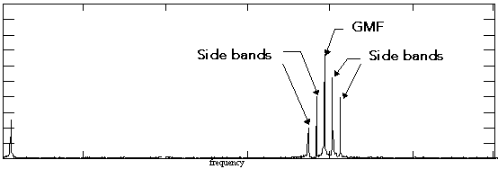
Normal Spectrum
All peaks are of low amplitudes
No natural frequency of gear excited

Slide 82
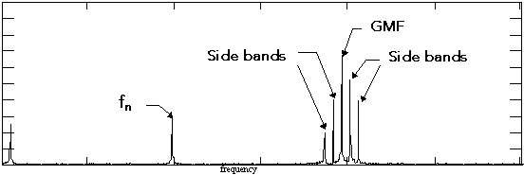
Tooth Wear
GMF may not change
High amplitudes of side bands
Presence of natural frequency of gear (f_{n})

Slide 83
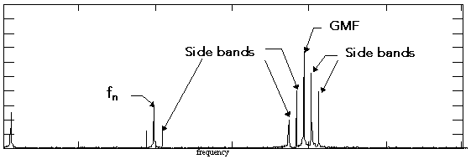
Gear Eccentricity & Backlash
Excites GMF, f_{n} & their side bands
High amplitudes of side bands
Sideband spacing reveals the defective
gear or pinion.

Slide 84
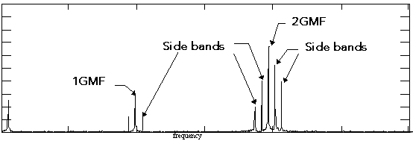
Gear Misalignment
Excites harmonics of GMF with side bands
Amplitudes 2GMF or 3GMF higher than 1GMF

Slide 85
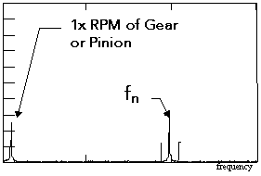
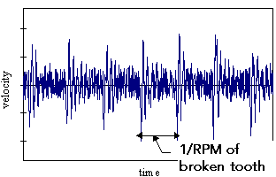
Cracked / Broken Tooth
High amplitudes of 1x RPM of gear or pinion
Excites gear natural frequency.
Time waveform indicates spikes at 1/RPM of broken or cracked tooth.
Amplitudes of impact spikes in time waveform will be higher than
that of 1xRPM in FFT.

Slide 86
Hunting Tooth
1. Faults on both gear & pinion occured
during manufacturing.
2. Causes high vibration at low
frequencies (less than 600CPM)
3. Gear set emits growling sound.

Slide 87
Hunting Tooth Frequency
It is the rate at which a tooth in one gear mates with a particular tooth in the other gear.
For well designed gearboxes HTF is low.
HTF = GMF . (lowest common prime factor) /(Z1.Z2)
Ex:
Z1 = 63, Z2 = 12
Z1 = 63 = 7.3.3
Z2 = 12 = 3.2.2
lowest common prime factor = 3
HTF = GMF. 3 / (63.12) = GMF / 252

Slide 88
Belt Drive
BF (Belt Frequency) = Rps. .D / L
BF is the rotational frequency of the belt. Worn or mismatched belts will
produce radial vibration at BF and its harmonics. 2.BF is often dominant
with 2 sheaves in the system. BF is a subsyncronous vibration (below 1X).

Slide 89
Belt Drive
Eccentric sheaves
force
Eccentric sheaves will generate strong 1X radial components.
A common condition.
Looks like unbalance, but shows at both sheaves.

Slide 90
Belt Drive
Sheave misalignment
Off-set
Angular
Axial vibrations at 1X and BF with harmonics.

Slide 91
Electrical Motors

Slide 92
AC Motors
Asyncronous AC motors
Running speed:
where p = number of poles
f = line frequency
If no. of poles = 2.
The motor will have a sync. RPM of 3000
f_{s} = RPM_{sync} - RPM
where fs = slip frequency

Slide 93
AC Motors
All electrical machines vibrates at 2 . line frequency.
The reasons are expanding and collapsing magnetic fields.
This vibration is normal (to a degree).
The amplitude is a measure of the quality of the construction.

Slide 94
AC Motors
Coast Down Test
Vibration suddenly drops down after switching off the power

Slide 95
AC Motors
Faults possible to detect with vibration analysis:
Rotor thermal bow
Air gap eccentricity
Loose rotor
Eccentric rotor
Loose windings
Necessary data:
No. of stator slots (SPF)
No. of rotor bars (RBPF)
Line frequency (LF)
Slip frequency (SF)

Slide 96
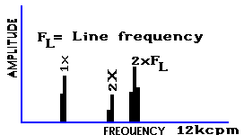
ELECTRICAL PROBLEMS
STATOR ECCENTRICITY
SHORTED LAMINATIONS
AND LOOSE IRON
Stator problems generate high amplitudes at 2F_{L} (2X line frequency )
Stator eccentricity produces uneven stationary air gap, vibration is very directional
Soft foot can produce an eccentric stator

Slide 97
FREQUENCIES PRODUCED BY ELECTRICAL MOTORS.
Electrical line frequency.(FL) = 50Hz = 3000 cpm.
60HZ = 3600 cpm
No of poles. (P)
Rotor Bar Pass Frequency (Fb) = No of rotor bars x
Rotor rpm.
Synchronous speed (_{Ns) =} 2xFL/P
Slip frequency ( F_{S} )= Synchronous speed - Rotor rpm
Pole pass frequency (F_{P} )= Slip Frequency x No of Poles.

Slide 98
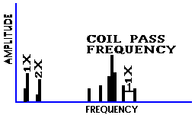
ELECTRICAL PROBLEMS
SYNCHRONOUS MOTOR
(Loose Stator Coils)
Loose stator coils in synchronous motors generate high amplitude at Coil Pass Frequency
The coil pass frequency will be surrounded by 1X RPM sidebands

Slide 99
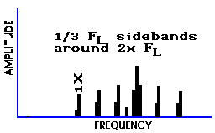
ELECTRICAL PROBLEMS
POWER SUPPLY
PHASE PROBLEMS
(Loose Connector)
Phasing problems can cause excessive vibration at 2F_{L} with 1/3 F_{L} sidebands
Levels at 2F_{L} can exceed 25 mm/sec if left uncorrected
Particular problem if the defective connector is only occasionally making contact

Slide 100
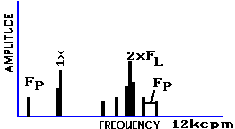
ELECTRICAL PROBLEMS
ECCENTRIC ROTOR
(Variable Air Gap)
Eccentric rotors produce a rotating variable air gap, this induces pulsating vibration
Often requires zoom spectrum to separate 2F_{L} and running speed harmonic
Common values of F_{P} range from 20 - 120 CPM

Slide 101
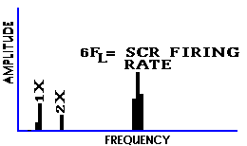
ELECTRICAL PROBLEMS
DC MOTOR PROBLEMS
DC motor problems can be detected by the higher than normal amplitudes at SCR firing rate
These problems include broken field windings
Fuse and control card problems can cause high amplitude peaks at frequencies of 1X to 5X Line Frequency

Slide 102

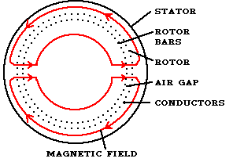

ELECTRICAL PROBLEMS
ROTOR PROBLEMS
1X, 2X, 3X, RPM with pole pass frequency sidebands indicates rotor bar problems.
2X line frequency sidebands on rotor bar pass frequency (RBPF) indicates loose rotor bars.
Often high levels at 2X & 3X rotor bar pass frequency and only low level at 1X rotor bar pass frequency.

Slide 103
AC Motors
Frequency analysis of input current
current clamp
In order to find 2 X slip sidebands around F_{L}, a analyzer
with high resolution, and preferably zoom around 50 Hz
is needed.

Slide 104
Resonance

Slide 105
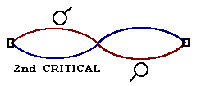
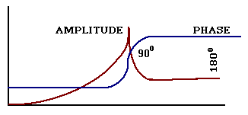
RESONANCE
Resonance occurs when the Forcing Frequency coincides with a Natural Frequency
180⁰ phase change occurs when shaft speed passes through resonance
High amplitudes of vibration will be present when a system is in resonance

Slide 106
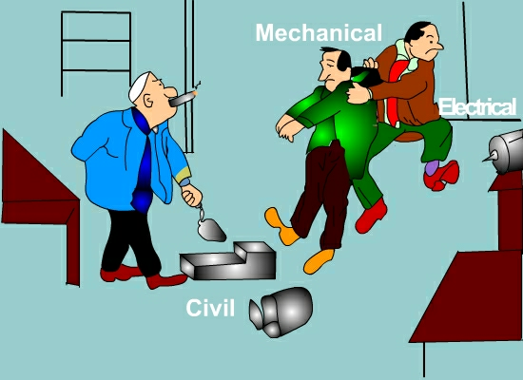

Slide 107
IF YOUR ONLY TOOL IS A HAMMER, THEN EVERY OBJECT APPEARS TO BE A NAIL.

